Slide 1
Overview of the Biohydrogen Experiment
Erasmus+
Sustainability by Biotechnology
Reneé Ristl
Daniel Csapo

Slide 2
Biohydrogen Production
Substrate I
(Sugar beet cuttings)
Substrate II
(Culture medium)
H₂O
76-78°C

Slide 3
Biohydrogen Production
37°C
H₂O

Slide 4
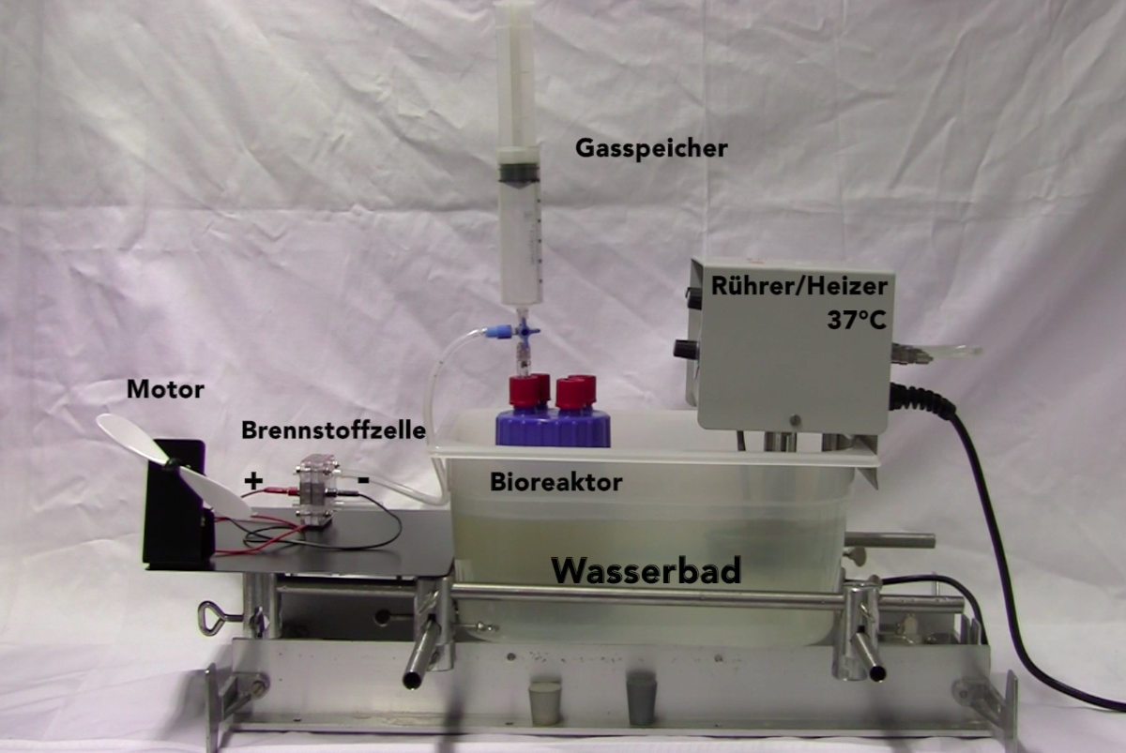
Syringe
Heater 37°C
Motor
Fuel Cell
Fermenter
Waterbath

Slide 5
Gas Chromatography
Detector
H₂
Thermal conductivity
CO₂
Time

Slide 6
Fuel Cell
Multimeter
mA
Membrane
-
+

Slide 7
Fuel Cell
-
-
+
+
Motor
Fuel Cell

Slide 8
