Slide 1



Erasmus+
Sustainability by Biotechnology
Production of Bio-Hydrogen by Butanoic Acid Fermentation
Adrian Wawruschka
Jana Grombirikova

Slide 2
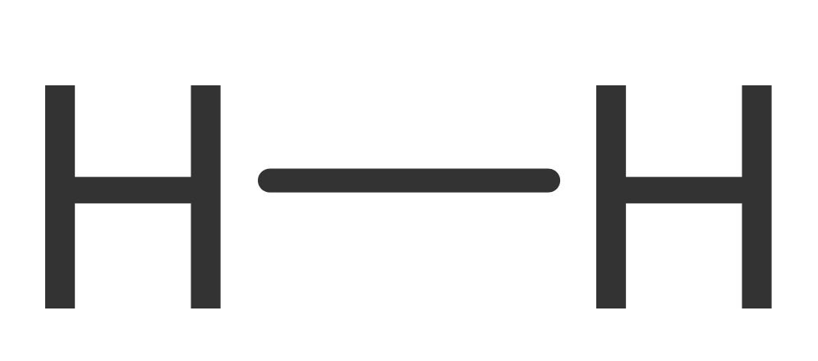
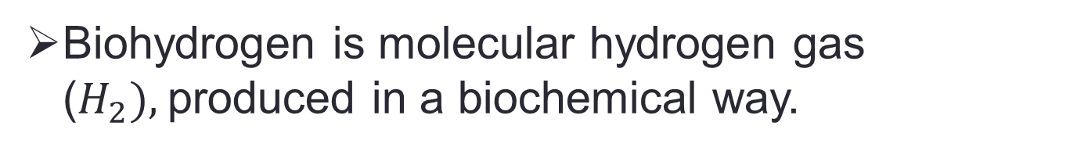
What is Biohydrogen?
Biohydrogen is molecular hydrogen gas ($H_{2}),$produced in a biochemical way.
Biohydrogen is a frequent product of microbial metabolism, in particular types of fermentation.

Slide 3
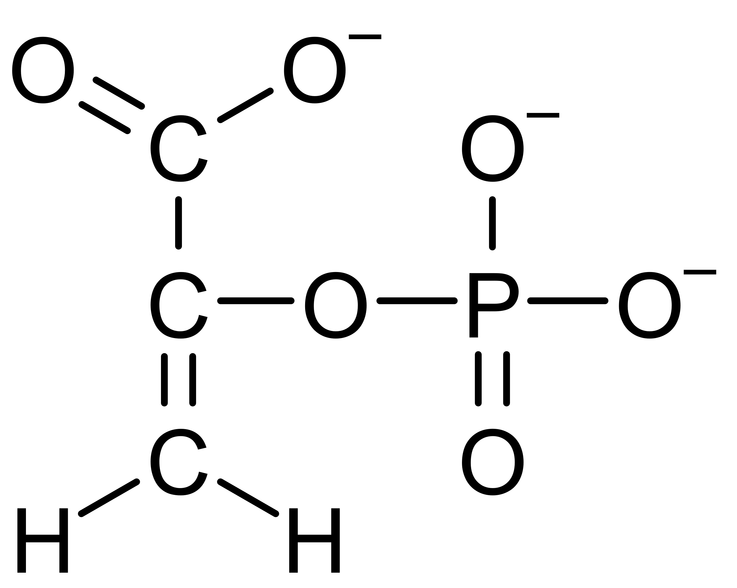
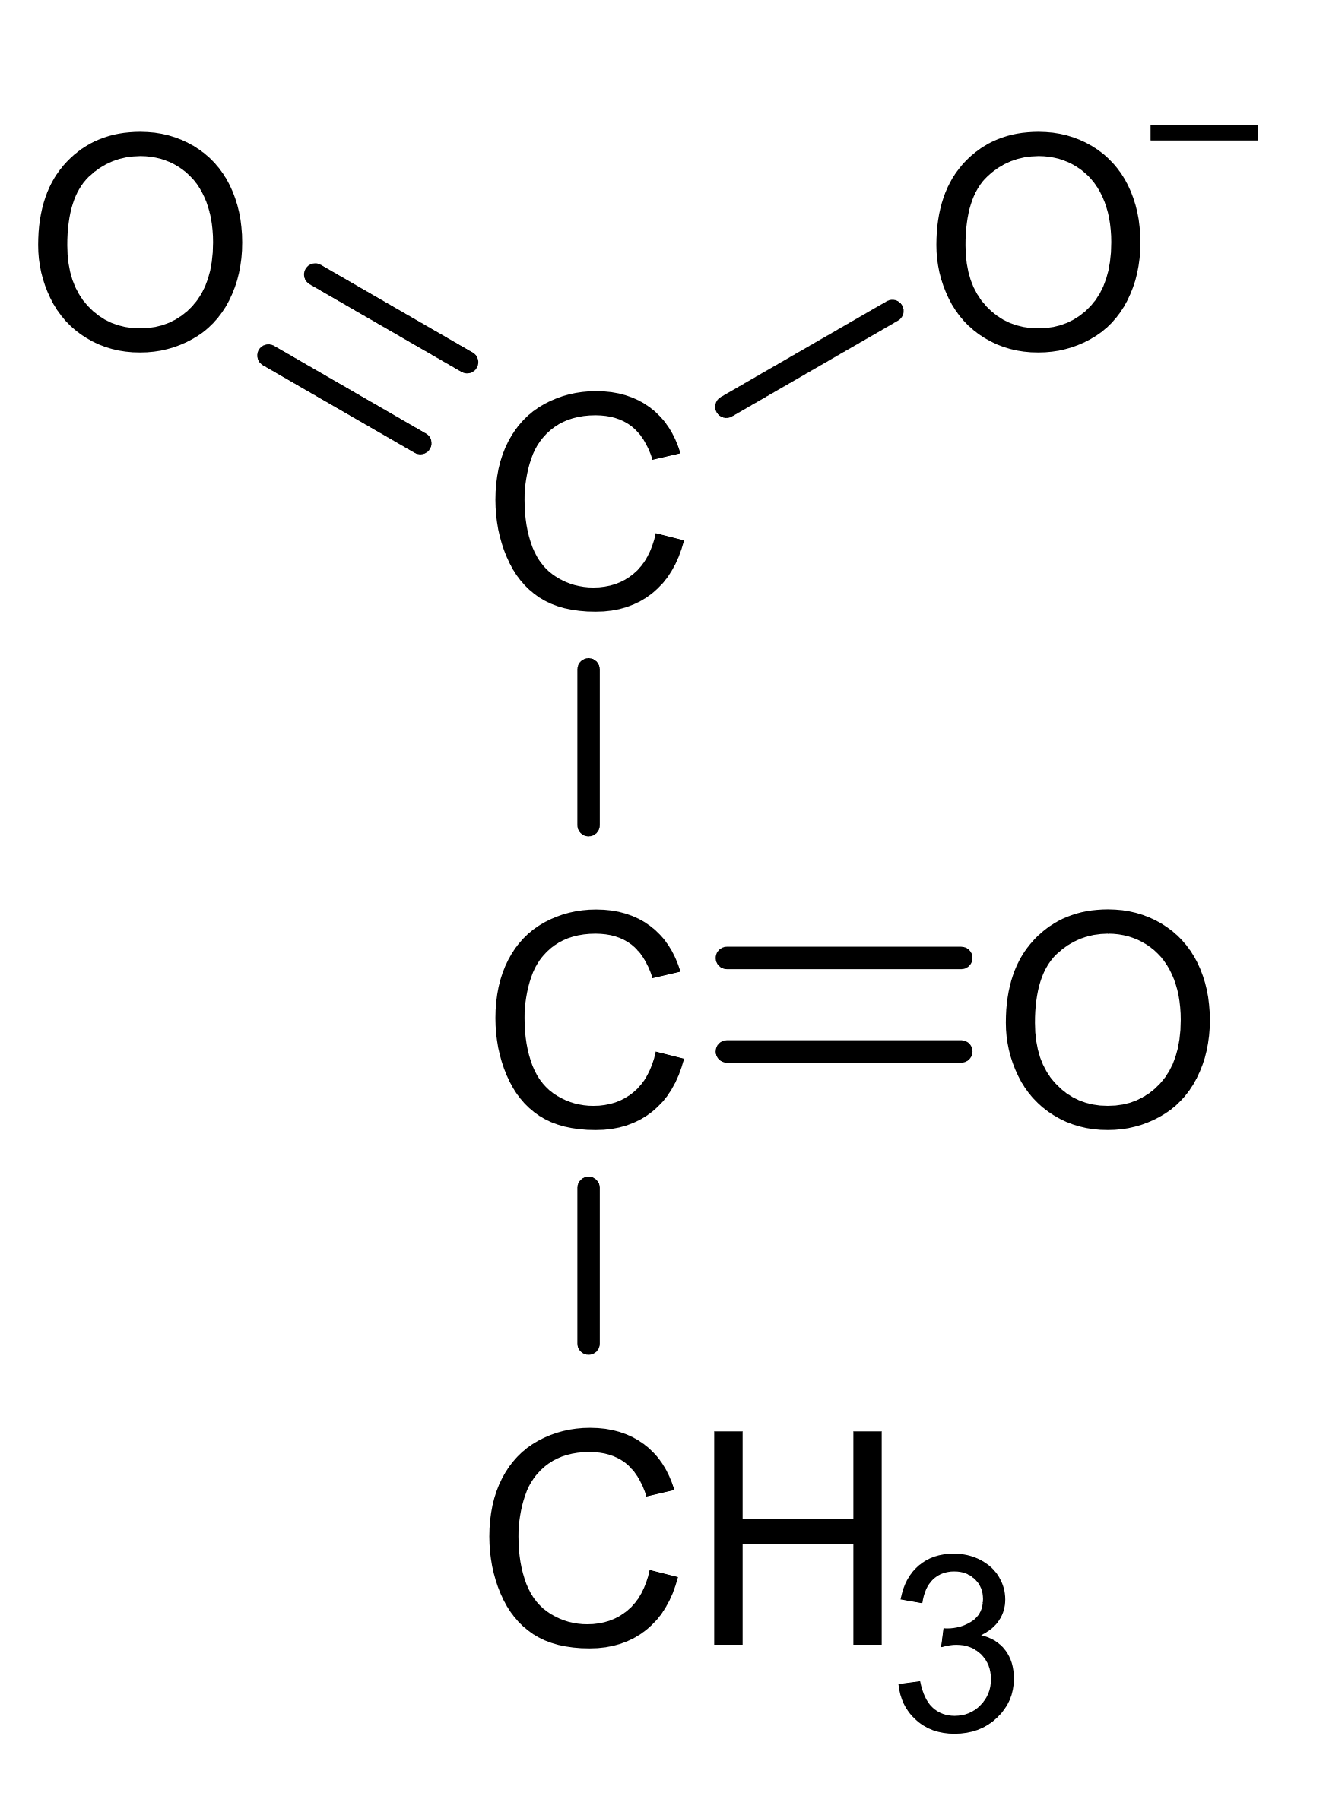
Fermentation
Degradation of organic substances in anaerobic conditions
Energy is produced by particular ways of fermentation (substrate-level phosphorylation).
That means the direct phosphorylation from ADP under anaerobic condition
For e.g. During the production of pyruvate and ATP out of phosphoenolpyruvate and ADP during glycolysis.
ADP
ATP
Phosphoenolpyruvate
Pyruvate

Slide 4
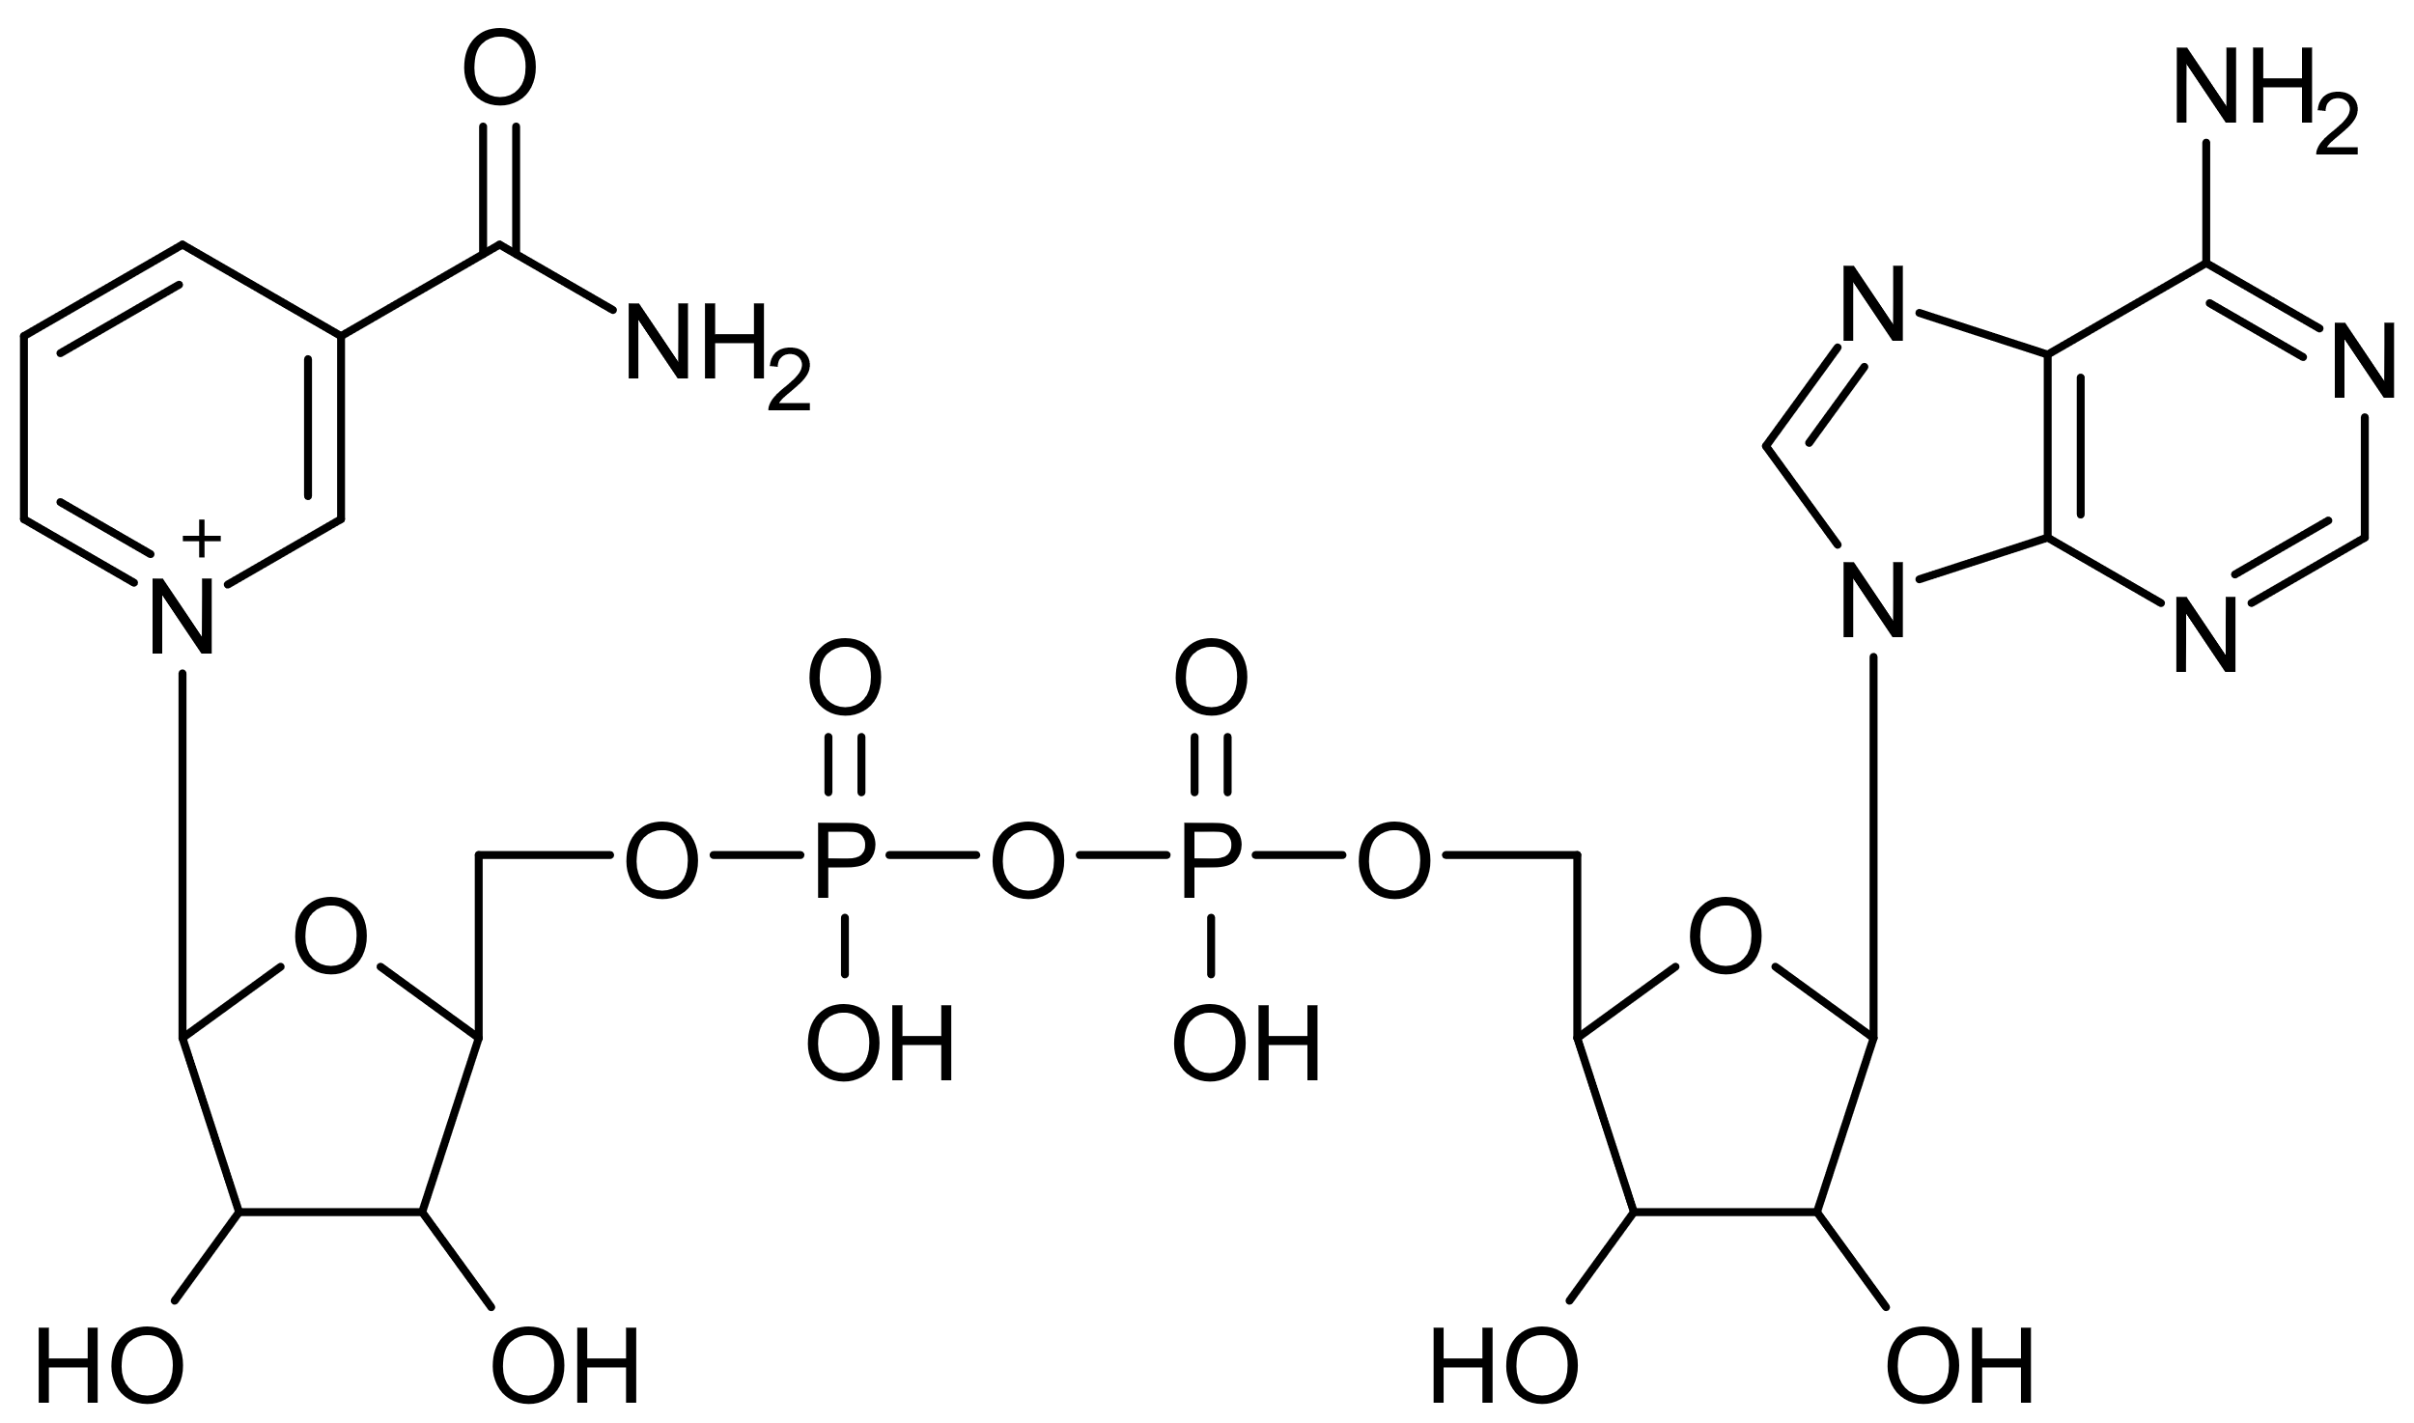
Goal of Fermentation
→ Regeneration of NAD⁺, which is used during glycolysis
Nicotinamid
Purin-Base Adenin
2 Phosphate-groups
sugar Ribose
sugar Ribose

Slide 5
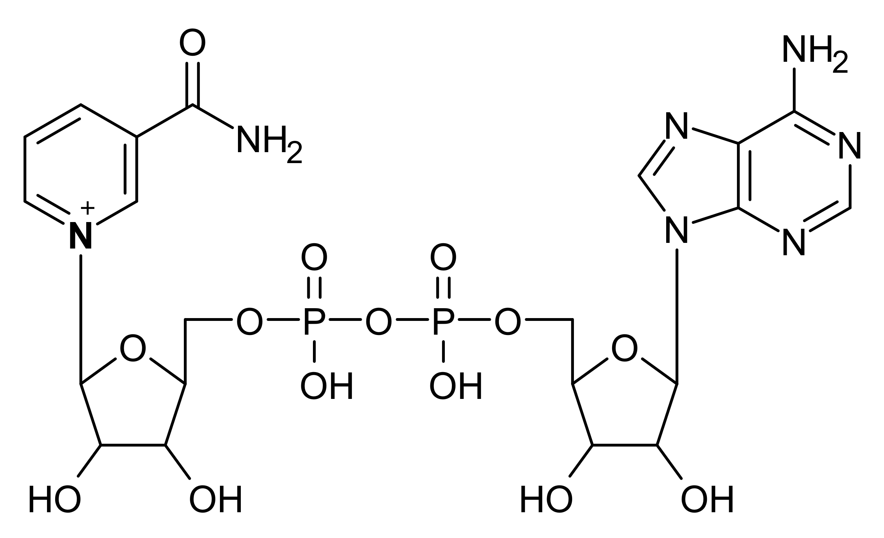
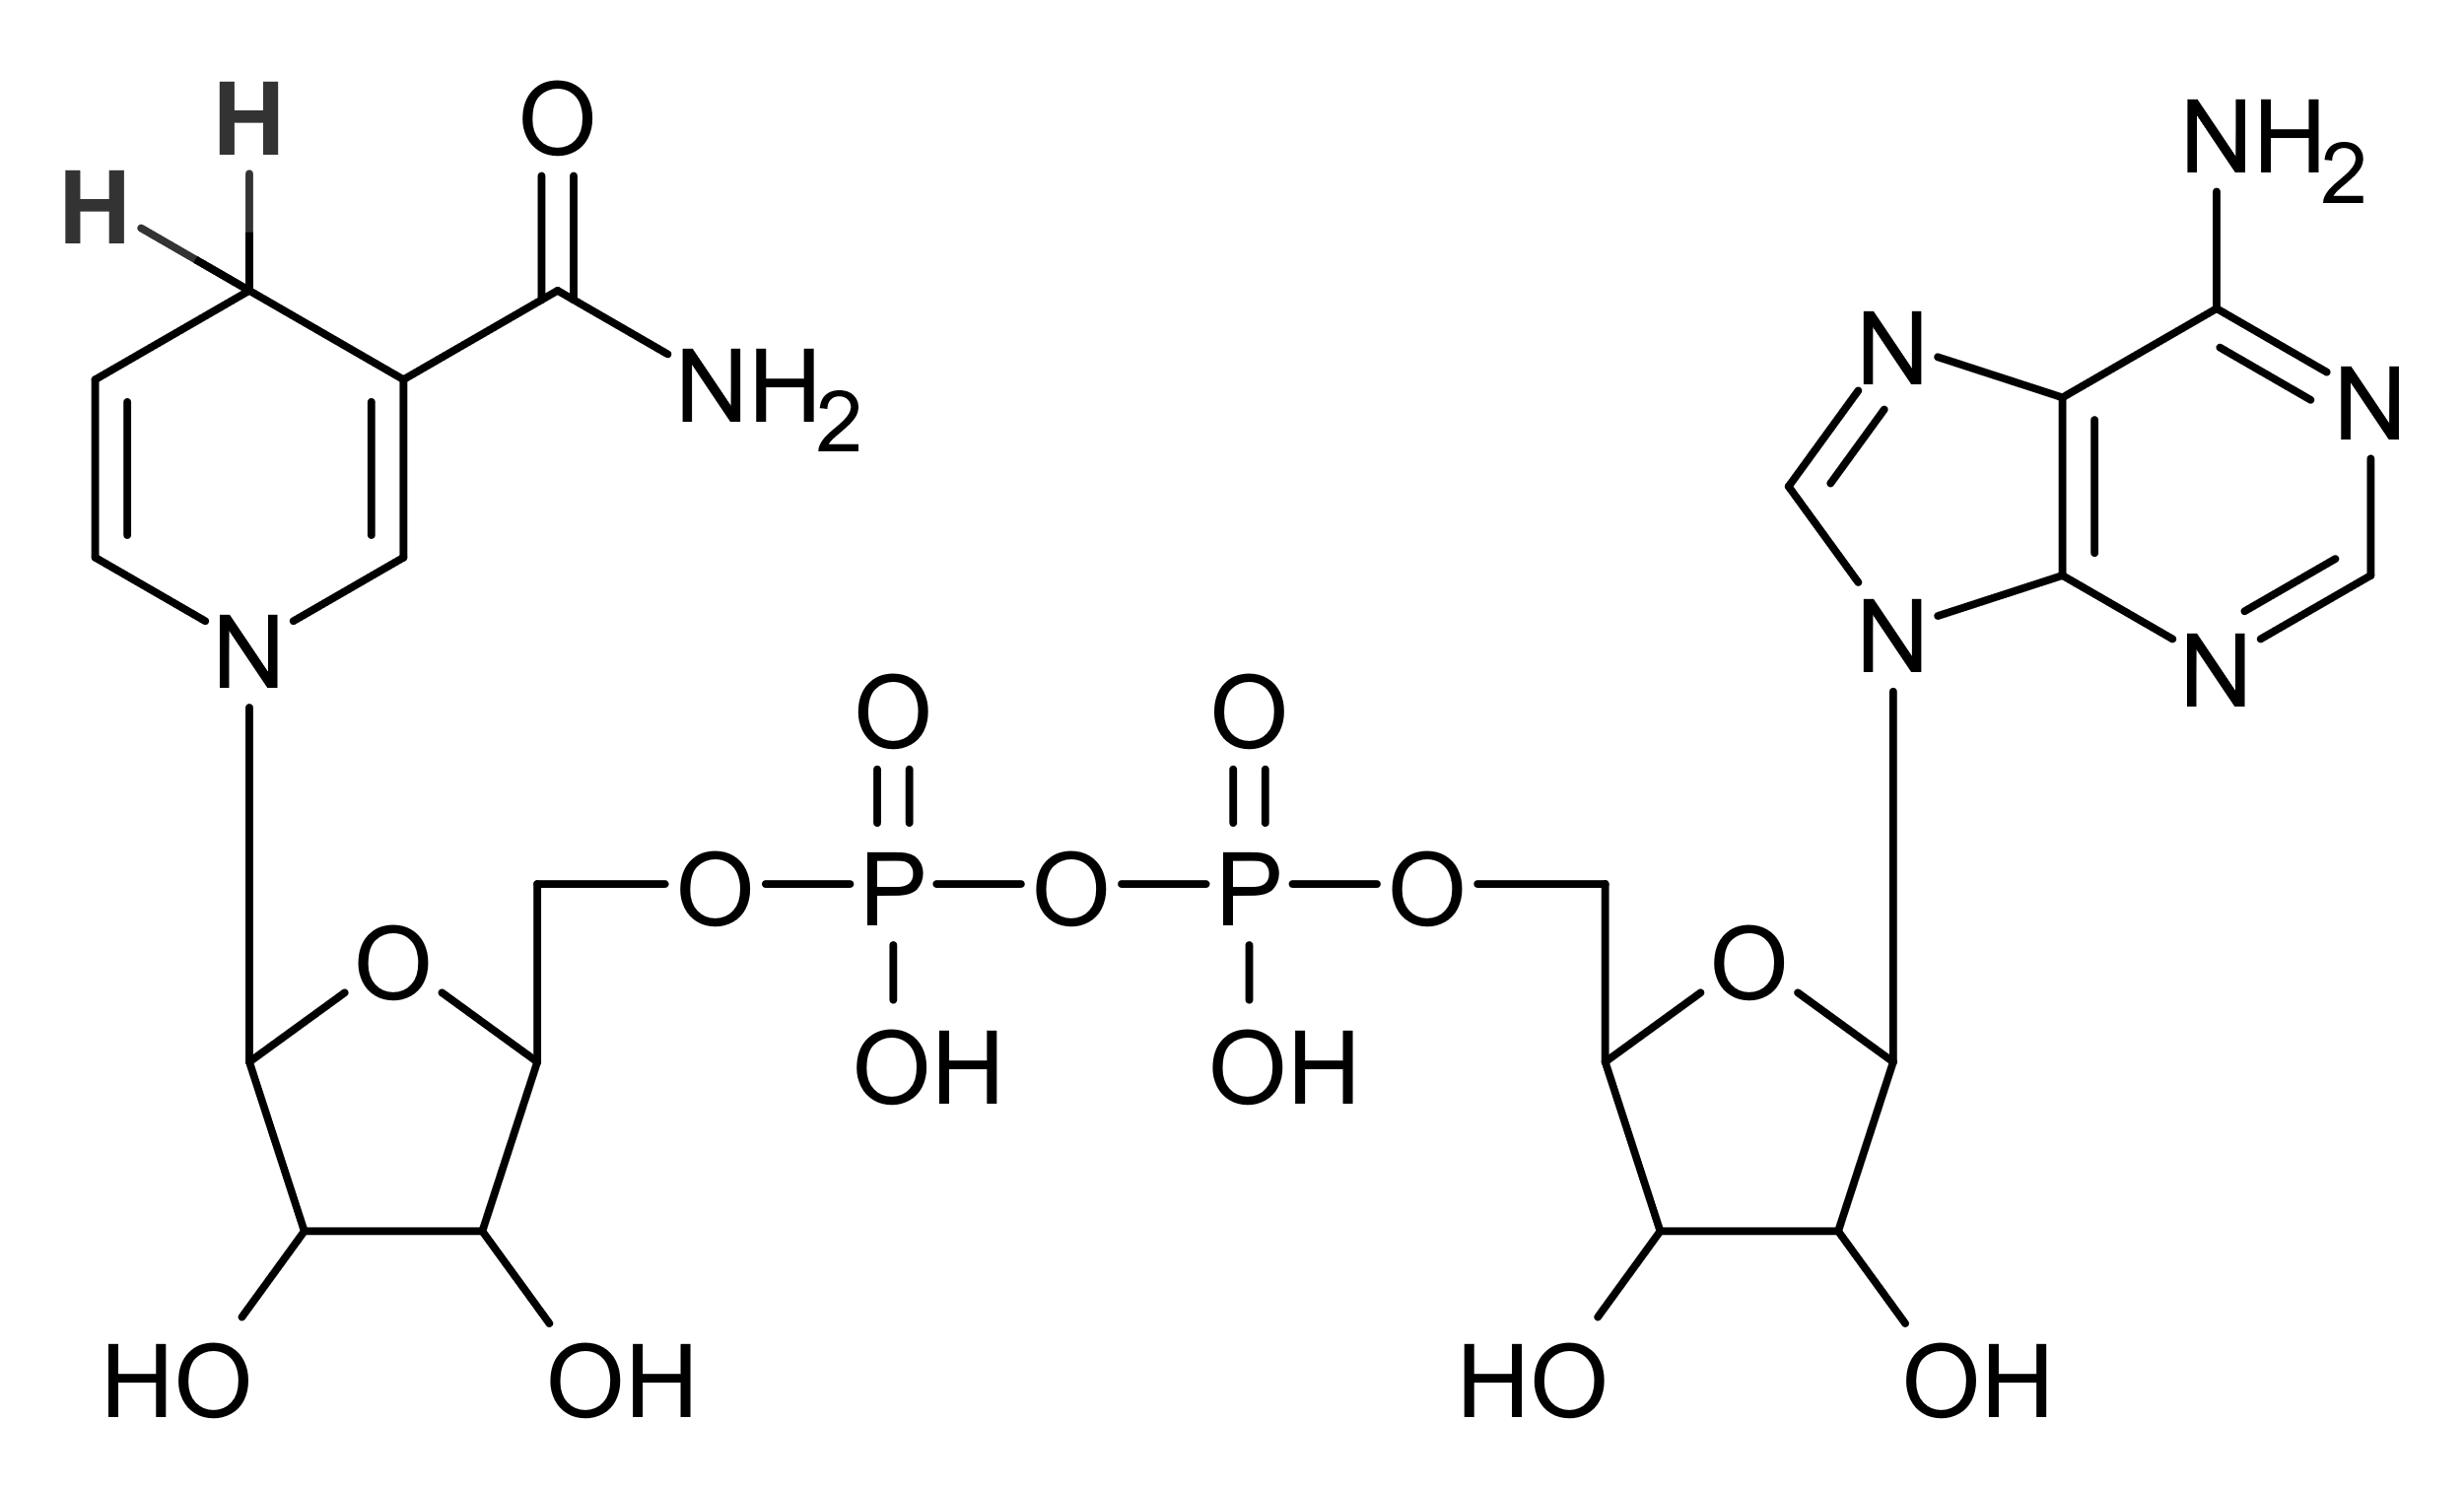
Goal of the Fermentation
NAD+
NADH+H+
Built during fermentation
Built during glycolysis

Slide 6
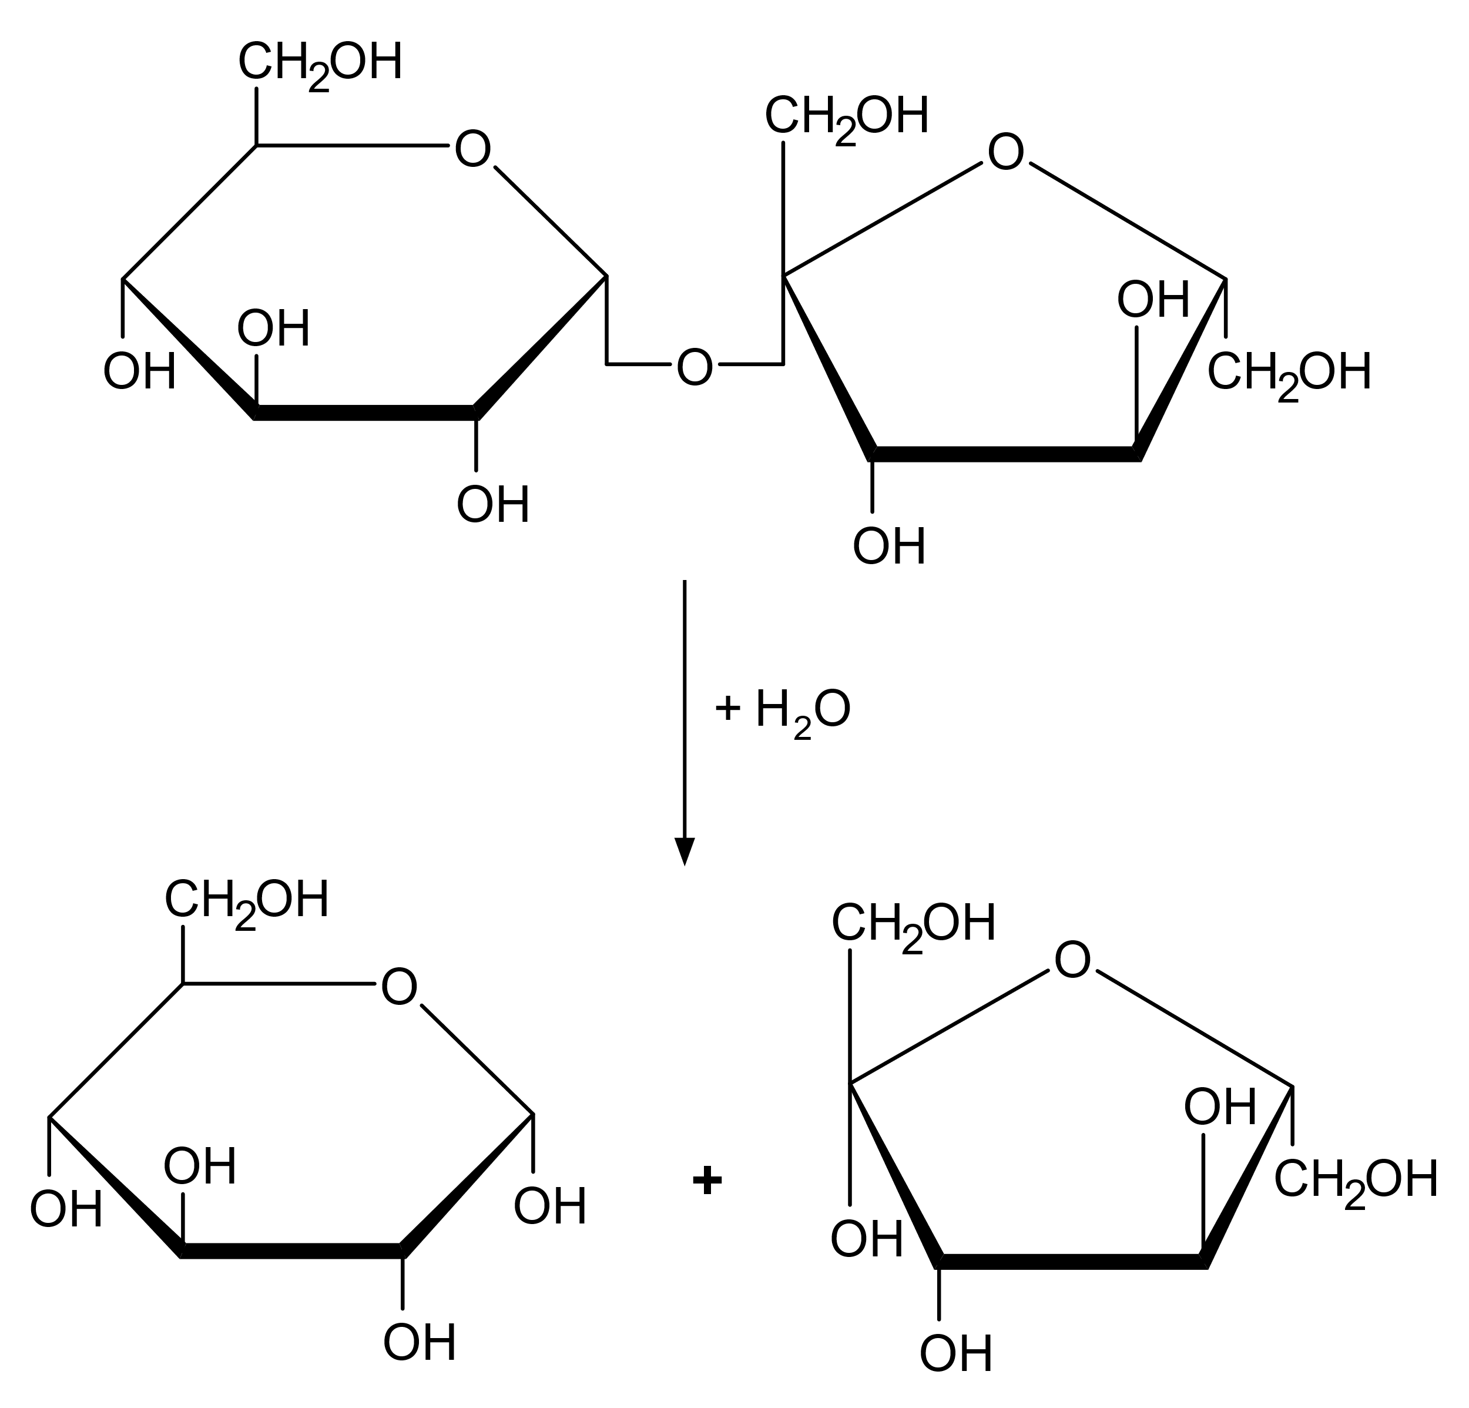
1. Step: Hydrolysis of Saccharose
Disaccharide saccharose is hydrolytically split
Glucose and Fructose develop
Glucose is oxidized during glycolysis
Glycolysis

Slide 7
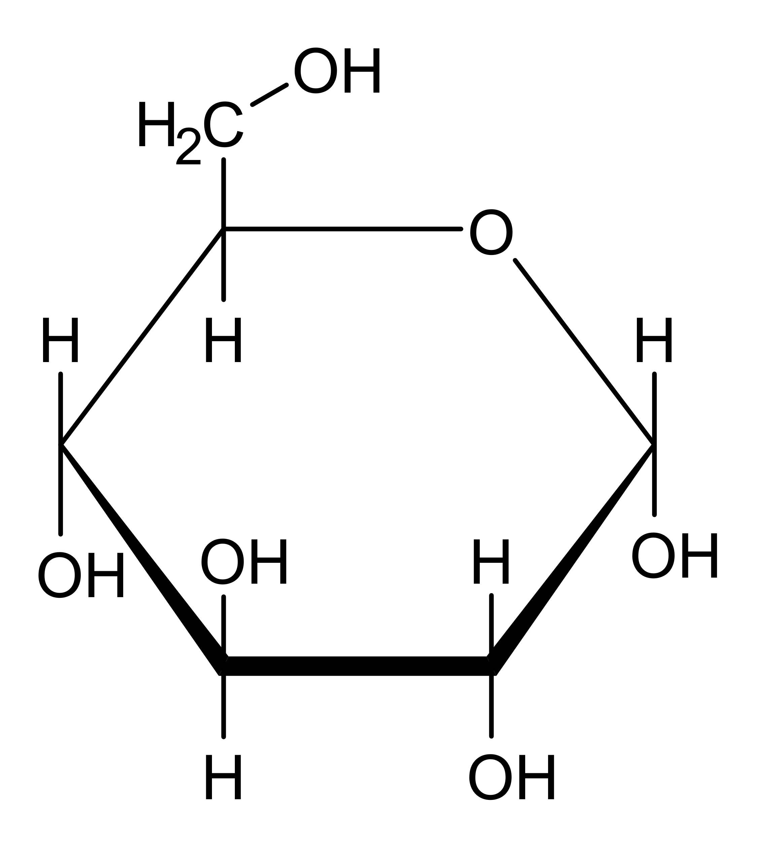
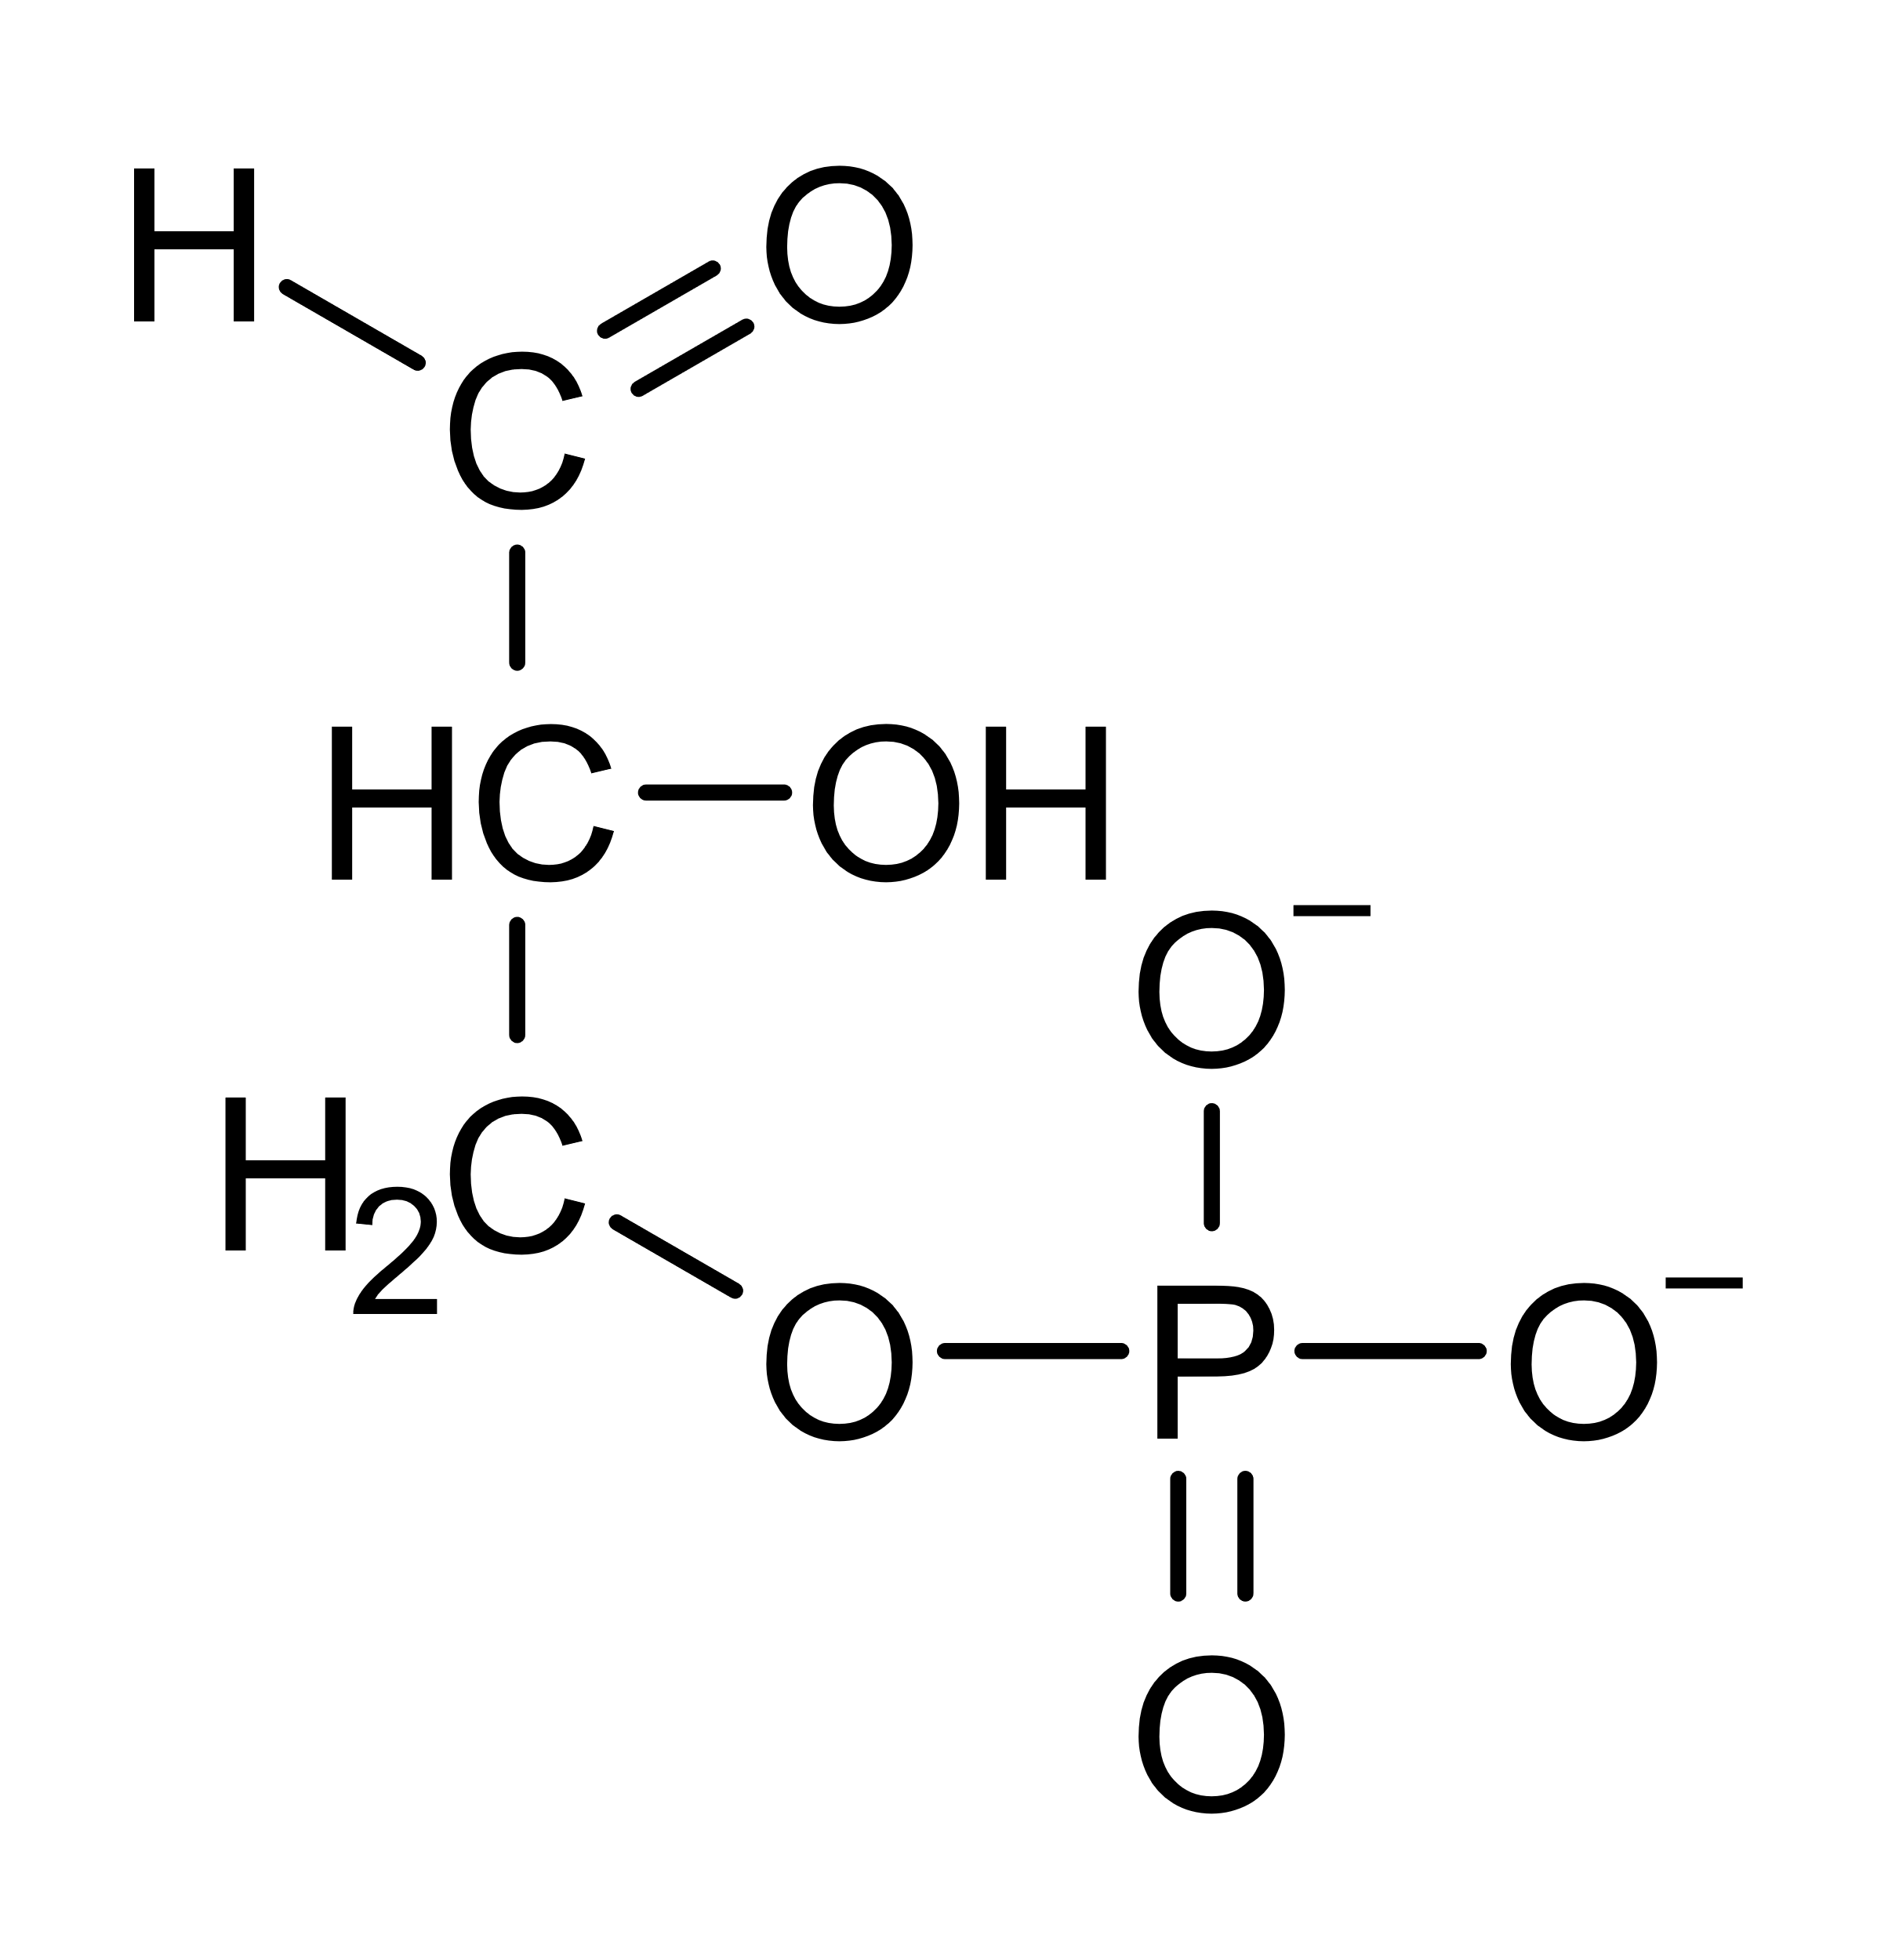
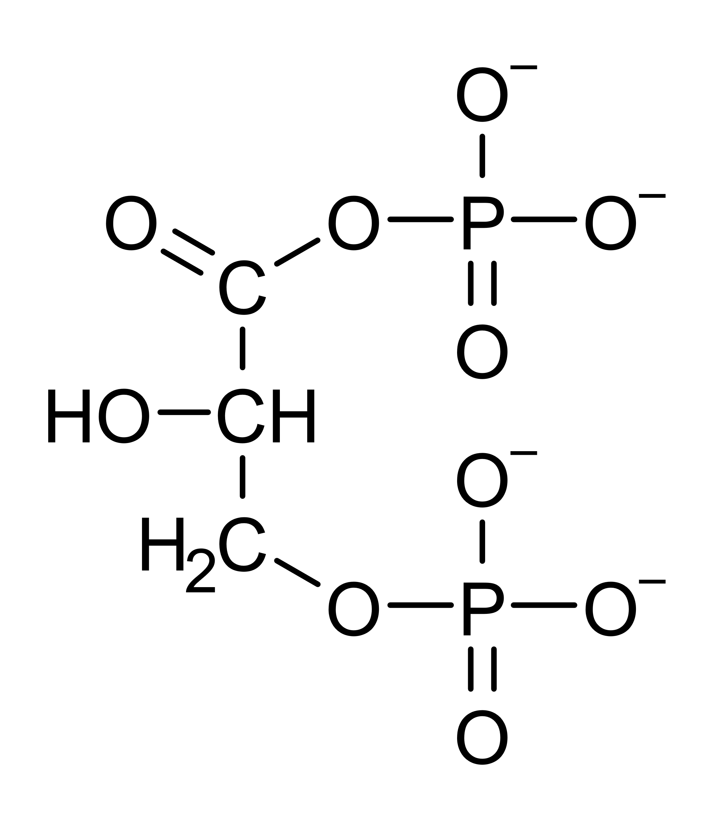
Glycolysis
Glucose
Problem: Glycolysis consumed NAD⁺
In the next step, (butanoic fermentation), NAD⁺ will be regenerated again.
2
Glyceraldehyde-3-phosphate (3-PGA)
2 P_{i}, 2 NAD⁺
2 NADH + H⁺
2
2
Butanoic acid fermentation
1,3-Bisphosphoglycerate
Pyruvate

Slide 8
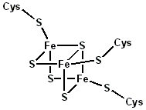
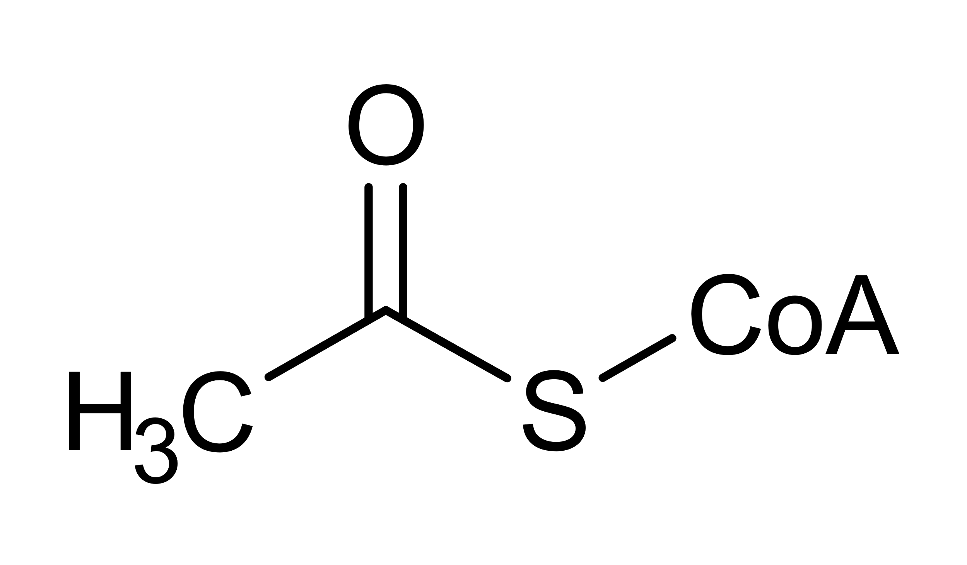
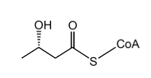
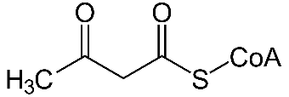

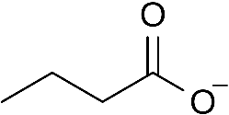







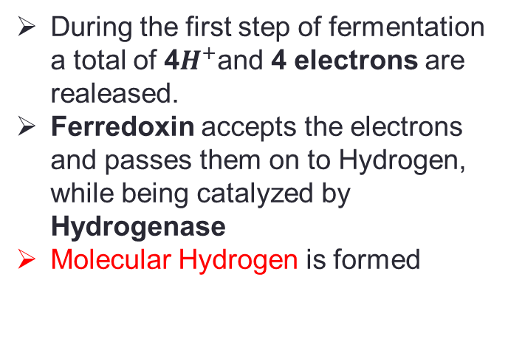

Butanoic Acid Fermentation
2
During the first step of fermentation a total of 4$H^{+}$and 4 electrons are realeased.
Ferredoxin accepts the electrons and passes them on to Hydrogen, while being catalyzed by Hydrogenase
Molecular Hydrogen is formed
Ferredoxine
Pyruvate
2 CoA-SH
$${Fd}_{red}$$
$${4H}^{+}$$
2${CO}_{2}$
2$H_{2}$
2$H_{2}$
$${Fd}_{ox}$$
2
Acetyl-CoA
Acetyl-CoA
CoA-SH
ADP+P
ATP
NADH+$H^{+}$
NAD+
NAD+
NADH+$H^{+}$
Acetoacetyl-CoA
3-Hydroxybutyryl-CoA
Butyryl-CoA
Butyrate

Slide 9
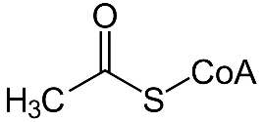





Closer Look at the First Step
2 CO₂
2 Pyruvate
2 CoA
e
$${Fd}_{ox}$$
Ferredoxine
4$H^{+}$
$${Fd}_{red}$$
4${ e}^{−}$
2 Acetyl-CoA
$${Fd}_{ox}$$
2 H₂

Slide 10
Butanoic Acid Fermentation
2
During the first step of fermentation a total of 4$H^{+}$and 4 electrons are realeased.
Ferredoxin accepts the electrons and passes them on to Hydrogen, while being catalyzed by Hydrogenase
Molecular Hydrogen is formed
Ferredoxine
Pyruvate
2 CoA-SH
$${Fd}_{red}$$
$${4H}^{+}$$
2${CO}_{2}$
2$H_{2}$
2$H_{2}$
$${Fd}_{ox}$$
2
Acetyl-CoA
Acetyl-CoA
CoA-SH
ADP+P
ATP
NADH+$H^{+}$
NAD+
NAD+
NADH+$H^{+}$
Acetoacetyl-CoA
3-Hydroxybutyryl-CoA
Butyryl-CoA
Butyrate

Slide 11

Alcoholic Fermentation
Butanoic Acid Fermentation
Glucose
NAD⁺
ADP
ADP
NAD⁺
NADH + H⁺
ATP
ATP
NADH + H⁺
H₂
$${CO}_{2}$$
Ethanal
Acetyl-CoA
ADP
NAD⁺
ATP
NAD⁺
Ethanol
Butanoic acid

Slide 12
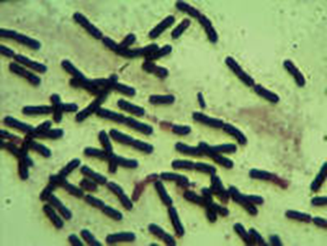
Bacteria of Butanoic Acid Fermentation
Some bacteria of the Clostridium class, e.g. Clostridium acetobutylicum
These bacteria are saccharolytic, therefore they use saccharose as substrate
( e.g. from sugar beet cuttings)
Condition of a neutral pH-value

Slide 13
Summary: Butanioc Acid Fermentation
Overview over the overall reaction (stoichiometrically not correct):
Glucose + 3 ADP + 3 P_{i} → butanoic acid + 2 H₂ + 2 CO₂ + 3 ATP

