Slide 1

Bacterial degradation of several plastics:
Test for viability and development of bacteria

Slide 2
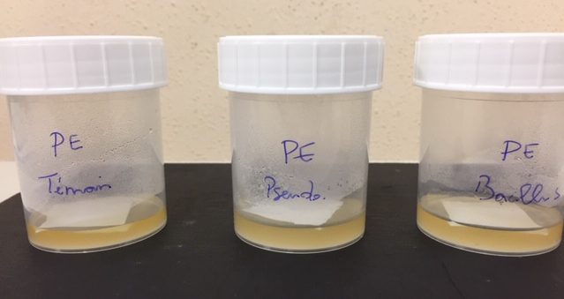
Group work
There are twelve groups.
Each group analyses one sort of plastic. There are six different plastic sorts, so two groups work with the same plastic.
Three prepared flasks are provided to each group.
Pseudomonas fluorescens (P)
Bacillus subtilis (B)
No bacteria (C)

Slide 3
1. Preparation
Tie up your hair.
Set your workspace like in the picture.
Turn on the Bunsen burner.
The Bunsen burner creates a sterile area of about 40 cm around itself.

Slide 4
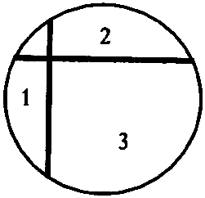
Preparation of the petri dish
1.4 Along the edge of the bottom of the petri dish, write:
the date,
the plastic material,
the type of bacteria,
group number.
On the bottom of the petri dish, draw two lines as it is shown from below.
Do not write the numbers.
date – plastic material – type of bacteria – group number

Slide 5
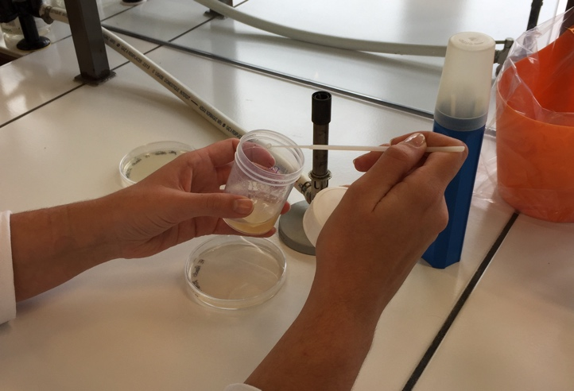
2. Sample collection
Sterilize the loop by heating in the flame of the Bunsen burner for 10 seconds.
The top of the loop has to glow red.
Cool it down by touching the agar.
Collect a sample of the liquid
medium with the sterilized loop.

Slide 6
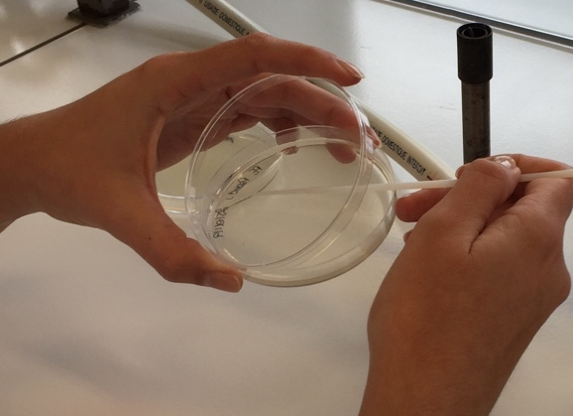
3. Inoculation
Work near the Bunsen burner.
Inoculate the nutrient agar with the bacteria sample as shown.
Never open the petri dish completely.
Between the steps (next slide),
close the petri dish.
When you open the petri dish, make sure
that the lid is always over the petri dish.

Slide 7
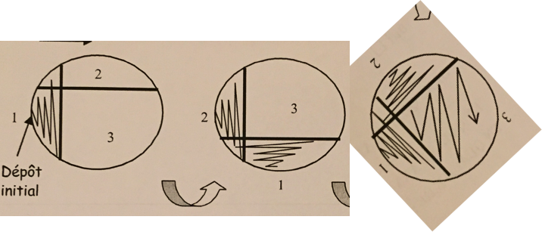
Spreading of the bacteria
First, spread the sample without pressure on area 1 of the petri dish. If you ever put pressure on the petri dish, you may destroy the agar. | Turn the petri dish 90° anticlockwise so you can spread the sample on area 2 without pressure. | Turn the petri dish anew anticlockwise for the area 3. Do not put pressure on the petri dish at all.

Slide 8
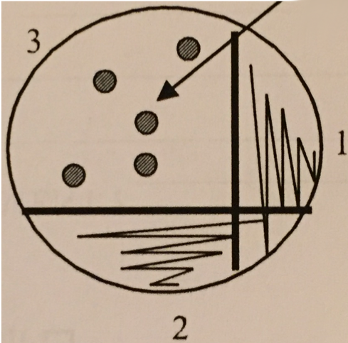
4. Incubation
Petri dishes are incubated at 37° C for 24 hours.
When it comes to analysis, make sure, to look at the third area because there the colonies are grown out of one single cell.

Slide 9
Tasks
Observe your results. Are there any differences in degradation rate of your plastic between Bacillus subtilis (B) and Pseudomonas fluorescens (P)?
Take a picture of each petri dish and interpret the results.
Prepare a presentation of your results and present it to the audience.

Slide 10
Tasks
Observe your results. Are there any differences in degradation rate of your plastic between Bacillus subtilis (B) and Pseudomonas fluorescens (P)?
  Are there any (small) holes or cracks in the plastic?
  Is the plastic more fragile than before?
Take a picture of each petri dish and interpret the results.
  Can you detect bacteria colonies?
  Compare your results to the negative control.
Prepare a presentation of your results and present it to the audience.
  You may compare your results to the group with the same plastic.

